Slide 1



New learnings, wonderings, and tensions: Explorations of a narrative inquiry into the impact of a social-emotional and academic learning program on students' lives
jmeegan@hiberniacollege.com
@JohnMeegan1

Slide 2
Presentation outline
Research context and finding a space
Aims and key questions
Theoretical approaches….and other voices
Methodological approach
Narrative analysis-Moving from field to research texts
New learnings, wonderings, and tensions

Slide 3
Research context and finding a space
You Can Do It! (YCDI)
YCDI education is a cognitive-behavioural theory (CBT) and social-emotional learning (SEL) based curriculum.
In 2014, two programs were introduced in my school:
  YCDI Education Early Childhood Program(ages 4-6 years old)
  Program Achieve-A Social and Emotional Learning Curriculum(7-11 years old)
YCDI focuses on developing positive habits of mind (ways of thinking), inside characteristics of students (the five foundations), and outside influences on students (effective teaching, positive parenting, and community support) to foster and promote positive relationships, behaviours, and well-being (Ashdown & Bernard, 2012; Bernard, 2012).
The five foundations of the program are Organisation, Confidence, Getting Along, Persistence, and Resilience.

Slide 4
Research context and finding a space
Several studies indicate the impact and effectiveness of the YCDI program and focus;
on the positive effect of YCDI lessons on students’ social-emotional development and well-being (Bernard 2006; Ashdown & Bernard, 2011;Bernard & Walton, 2011)
emotional resilience (Bernard& Pires2006; Bernard, 2008; Yamamoto,Matsumoto, & Bernard,2017)
attitudes and perceptions (Bernard & Walton, 2011)
academic achievement (Ashdown & Bernard, 2011).

Slide 5
Research context and finding a space
Social emotional learning (SEL)
Much research now presents evidence-based findings that positive SEL skills are linked to improved outcomes and dispositions in areas such as:
  social relationships, academic achievement, and school attendance (Zins & Elias, 2007; Weare & Nind, 2011; Taylor& Schellinger, 2011; Durlaket al., 2011; Clarke et al., 2015; Durlaket al.,2015; OECD, 2015; Corcoran et al., 2018).
  reading, mathematics, and science compared to traditional methods (Corcoran et al., 2018) . Findings from the Durlaket al (2011)meta-analysis of 231 controlled studies
  social behavior, and reduced emotional distress for students (Weissberget al.,2011).

Slide 6
Thesis Aims
Narratively inquire into students’ experiences of the five foundations of the social-emotional and academic learning program ‘You Can Do It (YCDI) Program Achieve’ (2007)
Explore the impact the program had on their lives on and off the school landscape.
Present and explore how eight primary school children composed their individual stories to live by, a narrative form of identity (Clandinin & Connelly, 2000).

Slide 7
Thesis Aims
Freeman (2007: 12) tells us that ‘realizations, narrative connections, are made after the fact when the dust has settled. The result is that we are frequently late in our own understanding of things.’
An emergent aim
To explore and consider YCDI conversations as spaces where children engaged in meaning and identity-making, where tensions arose as stories bumped against dominant cultural, institutional, and social narratives in an out-of-classroom place

Slide 8
Key questions
What might I learn by inquiring into these experiences, where children’s stories of the YCDI foundations and the program intersect and bump against school stories and other stories we live in (Morris, 2002)
How might inquiring into emerging tensions deepen understanding of cultural, institutional, and social narratives shaping the students' lives and stories?
How might my inquiry expand knowledge about the YCDI program and the meeting of diverse lives on school landscapes?

Slide 9
THE SALES CYCLE

Slide 10
Phone
Email
Online Chat
Whatsapp
Quality
Control

Slide 13
Add text
  Add text
Add text
Add text
Add text
  Add text
Add text
Add text

Slide 14
Sample text
Sample text
Sample text
YEAR
YEAR
YEAR
YEAR
YEAR
YEAR
Sample text
Sample text
Sample text

Slide 17
Description
Description
Description
Description
Topic A
Topic B
Description
Description
Description

Slide 21


Slide 22
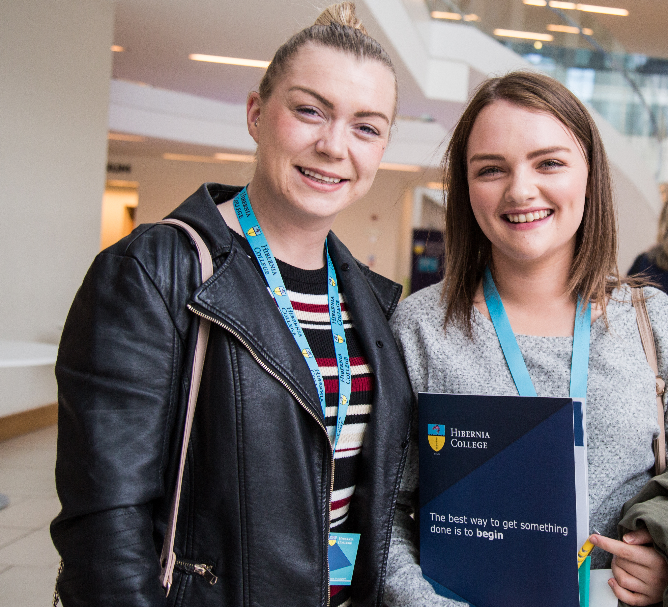

Slide 23


Slide 24

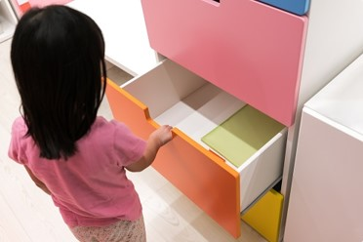

Slide 25
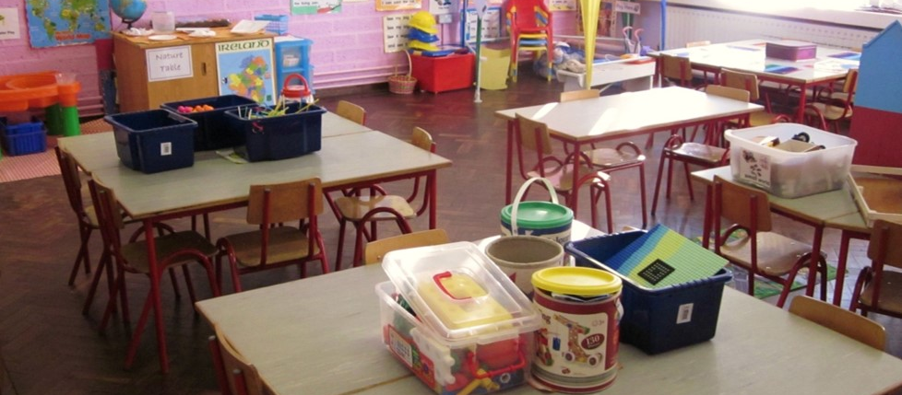


Slide 26
